Slide 1
HND Computing Software Development: Object Oriented Programming (H171 35)
Lecturer – Dawn Wilson

Slide 2
XAML
Most WPF designers use a combination of techniques and layout their user interface with a design tool (Visual Studio) and then fine tune it by editing the XAML
Easiest to write XAML by hand until you learn about layout containers because you need to use a layout container to properly arrange multiple controls in a window
Every element in XAML maps to an instance of .NET class. The name of the element matches the name of the class e.g. <Button instructs WPF to create a Button object
You can nest one element inside another to express containment
You can set properties of each class through attributes, but sometimes you need to use nested tags with a special syntax
www.w3schools.com/xml

Slide 3
XAML top-level element – only 1 allowed
Window
Page – similar to window but used for navigable applications
Application – which defines application resources and startup settings

Slide 4
XAML
xmlns – XML namepsace – defines .NET namespace of where the class is located
presentation is the core WPF namespace – encompasses all WPF classes including controls to build interfaces
xaml is the XAML namespace – includes XAML utility features. The namespace is mapped to the prefix x meaning that you can apply it by placing the namespace prefix before the element name i.e. <x:ElementName>

Slide 5
The code-behind class
XAML allows you to construct a user interface, but to make it function you need a way to connect the event handlers that contain your application code. This is done in XAML using the class attribute
<Window x:Class=“WindowsApplication1.Window1”
The class attribute gets placed in the XAML namespace (x)
The class attribute tells the XAML parser to generate a new class with the specified name
This example will create a new class named Window1 that is derived from the base Window class(this will be your code behind file)

Slide 6
Naming elements
Often you will want to manipulate the XAML controls in your code-behind file. You can only manipulate an element if it has a name. To make this possible , the control must include a XAML Name attribute
In the previous XAML snippet, the Grid control didn’t have a name, so it could not be manipulated by the code-behind file. To enable this we add a name to the element:
<Grid x:Name=“grid1”>
</Grid>
You can add the name directly to the XAML or update the “Property”

Slide 7
Interacting with named elements
The Name attribute tells the XAML parser to add a field to the auto-generated portion of the Window1 class:
private System.Windows.Controls.Grid grid1;
Now you can interact with the Grid using the name grid1
This is more valuable for controls such as textboxes where you want to read values out of textboxes, etc.

Slide 8
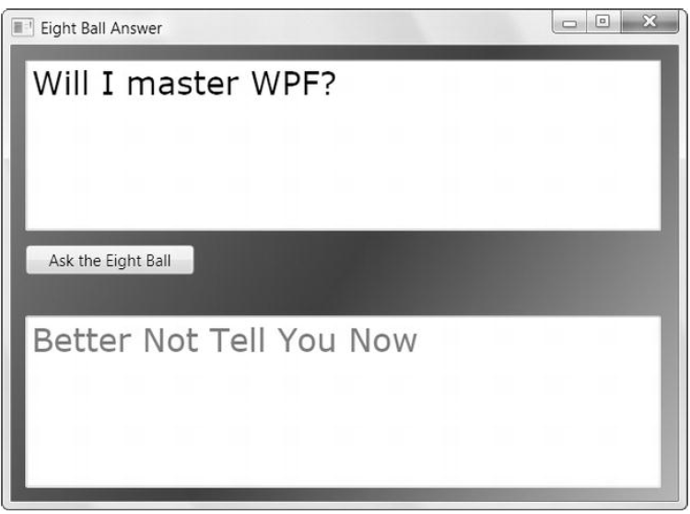
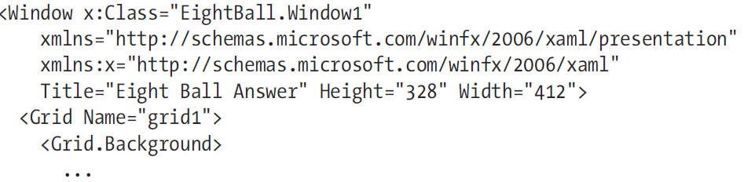
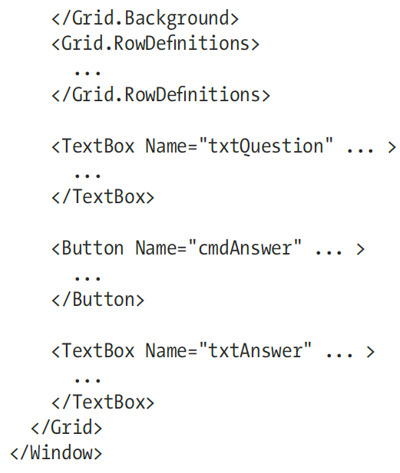

Slide 9
XAML – creating controls
XAML is case-sensitive and the control name has to correspond to a type in the .NET Framework
creating a control in XAML is as easy as writing it's name, surrounded by angle brackets. For instance, a Button looks like this:
<Button>
XAML tags has to be ended, either by writing the end tag or by putting a forward slash at the end of the start tag:
<Button></Button> Or <Button />
The same goes for attribute names which corresponds to the properties of the control
<Button FontWeight="Bold" Content="A button" />

Slide 10
XAML – creating controls
all attributes of a control may also be defined like this, where they appear as child tags of the main control, using the Control-Dot-Property notation:
<Button> <Button.FontWeight>Bold</Button.FontWeight> <Button.Content>A button</Button.Content> </Button>
a lot of controls allow content other than text, for instance other controls. Here's an example where we have text in different colours on the same button by using several TextBlock controls inside of the Button:
<Button> <Button.FontWeight>Bold</Button.FontWeight> <Button.Content> <WrapPanel> <TextBlock Foreground="Blue">Multi</TextBlock> <TextBlock Foreground="Red">Color</TextBlock> <TextBlock>Button</TextBlock> </WrapPanel> </Button.Content> </Button>
The Content property only allows for a single child element, so we use a WrapPanel to contain the differently coloured blocks of text
Panels act like containers for other controls

Slide 11
XAML – creating controls
The previous result can be also be accomplished using the following markup:
<Button FontWeight="Bold"> <WrapPanel> <TextBlock Foreground="Blue">Multi</TextBlock> <TextBlock Foreground="Red">Color</TextBlock> <TextBlock>Button</TextBlock> </WrapPanel> </Button>

Slide 12
Markup Extensions
In some cases it is not possible to hard-code the property value
Markup extension is specialised syntax that allows you to set a property in an non-standard way
They can be used in nested tags or XML attributes. When used in attributes they are enclosed in curly braces
This allows you to refer to a static property in another class
The end result is

Slide 13
Events
All of the controls, including the Window expose a range of events that you may subscribe to, meaning that your application will be notified when they occur and you may react to that
most commonly used events are those that respond to the user's interaction with your application using the mouse or the keyboard
KeyDown, KeyUp, MouseDown, MouseEnter, MouseLeave, MouseUp

Slide 14
Events
you need to know how to link a control event in XAML to a piece of code in your code-behind file:
<Window x:Class="WpfTutorialSamples.XAML.EventsSample" xmlns="http://schemas.microsoft.com/winfx/2006/xaml/presentation" xmlns:x="http://schemas.microsoft.com/winfx/2006/xaml" Title="EventsSample" Height="300" Width="300"> <Grid Name="pnlMainGrid" MouseUp="pnlMainGrid_MouseUp" Background="LightBlue"> </Grid> </Window>
we have subscribed to the MouseUp event of the Grid by writing a method name. This method needs to be defined in code-behind, using the correct event signature. In this case it should look like this:
private void pnlMainGrid_MouseUp(object sender, MouseButtonEventArgs e) { MessageBox.Show("You clicked me at " + e.GetPosition(this).ToString()); }

Slide 15
Events
MouseUp event uses a delegate called MouseButtonEventHandler, which you subscribe to. It has two parameters, a sender (the control which raised the event) and a MouseButtonEventArgs object that will contain useful information
We use it to get the position of the mouse cursor and tell the user about it
Several events may use the same delegate type - for instance, both MouseUp and MouseDown uses the MouseButtonEventHandler delegate, while the MouseMove event uses the MouseEventHandler delegate. When defining the event handler method, you need to know which delegate it uses and if you don't know that, you can look it up in the documentation
Visual Studio can help us to generate a correct event handler for an event. The easiest way to do this is to simply write the name of the event in XAML and then let the IntelliSense of VS do the rest for you

Slide 16
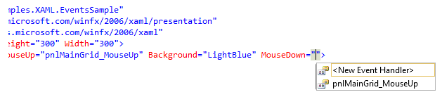
Events
When you select <New Event Handler> Visual Studio will generate an appropriate event handler in your Code-behind file. It will be named <control name>_<event name>, in our case pnlMainGrid_MouseDown. Right-click in the event name and select Navigate to Event Handler and VS will take you right to it

Slide 17
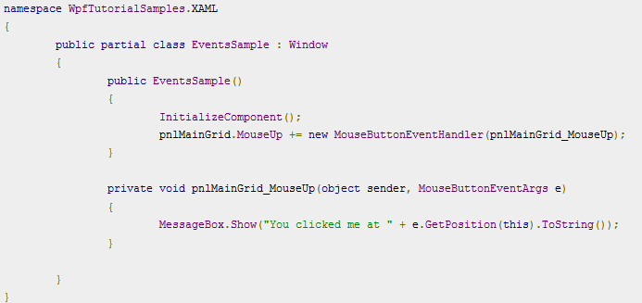
Subscribing to an event from code-behind file
there may be times where you want to subscribe to the event directly from Code-behind instead. This is done using the += C# syntax, where you add an event handler to event directly on the object

Slide 18
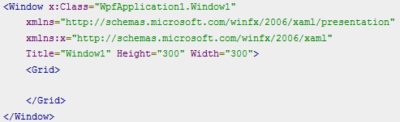
XAML – Window
It serves as the root of a window and provides you with the standard border, title bar and maximize, minimize and close buttons. A WPF window is a combination of a XAML (.xaml) file, where the <Window> element is the root, and a CodeBehind (.cs) file
The x:class attribute tells the XAML file which class to use, in this case Window1, which Visual Studio has created for us as well
notice that Visual Studio has created a Grid control for us inside the Window. The Grid is one of the WPF panels, and while it could be any panel or control, the Window can only have ONE child control, so a Panel, which in turn can contain multiple child controls, is usually a good choice

Slide 19
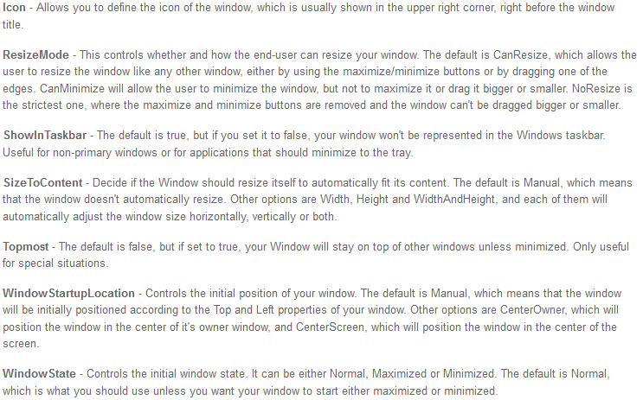
XAML – Window Properties
attributes that you may set to control the look and behaviour of your application window

Slide 20
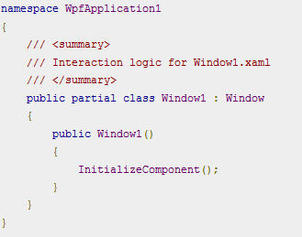
XAML – Window class
The class is defined as partial, because it's being combined with your XAML file in runtime to give you the full window.

Slide 21
App.xaml
declarative starting point of your application. Visual Studio will automatically create it for you when you start a new WPF application, including a Code-behind file called App.xaml.cs
App.xaml.cs extends the Application class, which is a central class in a WPF Windows application. .NET will go to this class for starting instructions and then start the desired Window or Page from there. This is also the place to subscribe to important application events
most commonly used features of the App.xaml file is to define global resources that may be used and accessed from all over an application, for instance global styles

Slide 22
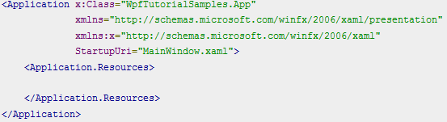
App.xaml structure
automatically generated App.xaml will look something like this:
notice the StartupUri property -this is actually the part that instructs which Window or Page to start up when the application is launched e.g. MainWindow.xaml will be started
You could replace this with a different page or a startup event, which you can then code in the .cs to perform additional startup tasks

Slide 23
Resources
ability to store data as a resource, either locally for a control, locally for the entire window or globally for the entire application.
This allows you to place data in one place and then use it from or several other places
used a lot for styles and templates

Slide 24
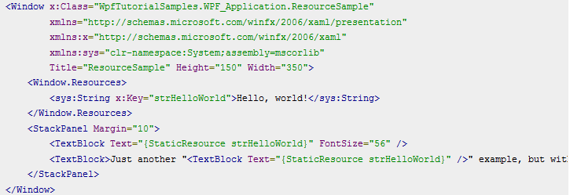
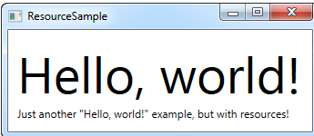
Resources example
Resources are given a key, using the x:Key attribute, which allows you to reference it from other parts of the application by using this key, in combination with the StaticResource markup extension. In this example, I just store a simple string, which I then use from two different TextBlock controls

Slide 25
Resources – static Vs dynamic
a static resource is resolved only once, which is at the point where the XAML is loaded. If the resource is then changed later on, this change will not be reflected where you have used the StaticResource
A DynamicResource on the other hand, is resolved once it's actually needed, and then again if the resource changes. Allows you to use resources which are not even there during design time, e.g. if you add them from Code-behind during the startup of the application

Slide 26
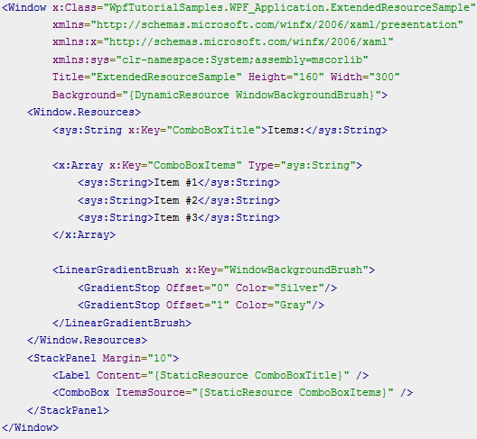
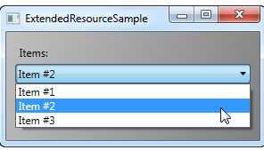
Resource Example
Added a couple of extra resources, so that our Window now contains a simple string, an array of strings and a LinearGradientBrush.
The string is used for the label, the array of strings is used as items for the ComboBox control and the gradient brush is used as background for the entire window.
So, as you can see, pretty much anything can be stored as a resource

Slide 27
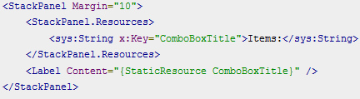
Local resources
If you only need a given resource for a specific control, you can make it more local by adding it to this specific control, instead of the window
In this case, we add the resource to the StackPanel and then use it from its child control, the Label. Other controls inside of the StackPanel could have used it as well

Slide 28
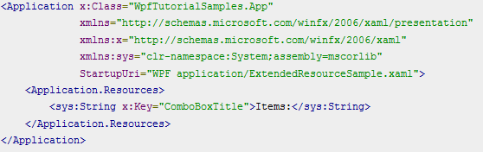

Application wide resources
the App.xaml file can contain resources which are then are globally accessible in all of windows and user controls of the project
Using it is also the same - WPF will automatically go up the scope, from the local control to the window and then to App.xaml, to find a given resource:

Slide 29
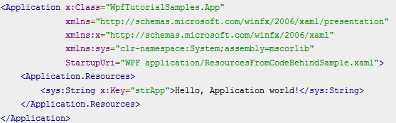
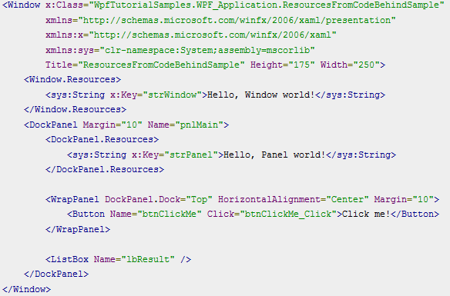
Accessing resources from code-behind
So far, we've accessed all of our resources directly from XAML, using a markup extension. However, you can of course access your resources from code-behind as well
We will access 3 different resources - one in App.xaml, one inside the window, and one locally for the main panel
window
App.xaml

Slide 30
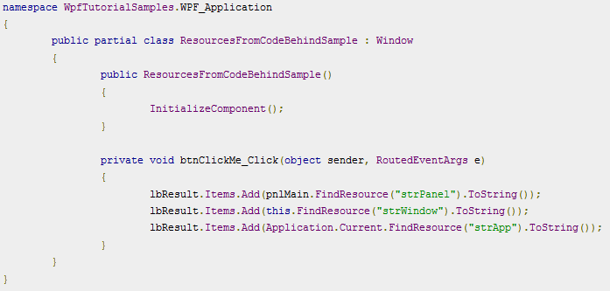
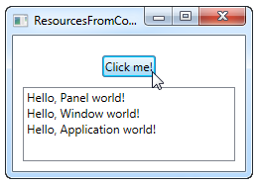
Accessing resources from code-behind
Code-behind
we handle the click event of the button, in which we add each of the text strings to the ListBox, as seen on the screenshot. We use the FindResource() method, which will return the resource as an object (if found), and then we turn it into the string that we know it is by using the ToString() method
we use the FindResource() method on different scopes - first on the panel, then on the window and then on the current Application object

Slide 31
Label controls Vs Textblock controls
Textblock
allows you to put text on the screen, much like a Label control does, but in a simpler and less resource demanding way
works very well for multiline strings as well, but can only contain text (strings)
supports inline content. These small control-like constructs all inherit from the Inline class e.g. Bold, Hyperlink, InlineUIContainer, Italic, LineBreak, Run, Span, and Underline
Label
Label has a Content property, allowing to host any kind of control directly inside of it, instead of just text
Specify a border
Render other controls, e.g. an image
Use templated content through the ContentTemplate property
Use access keys to give focus to related controls

Slide 32
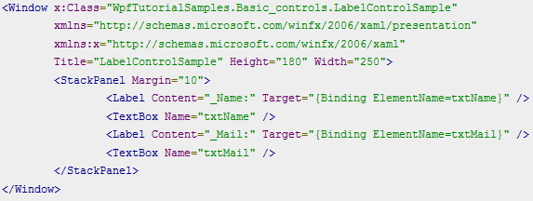
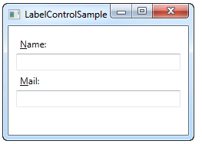
Label and Access Keys
it's common practice that you can access controls in a dialog by holding down the [Alt] key and then pressing a character which corresponds to the control that you wish to access – labels support this
holding down the [Alt] key and then pressing N and M. You will see how focus is moved between the two textboxes

Slide 33
Label and Access Keys
define the access key by placing an underscore (_) before the character. It doesn't have to be the first character, it can be before any of the characters in your label content
use the Target property to connect the Label and the designated control. We use a standard WPF binding for this, using the ElementName property

Slide 34
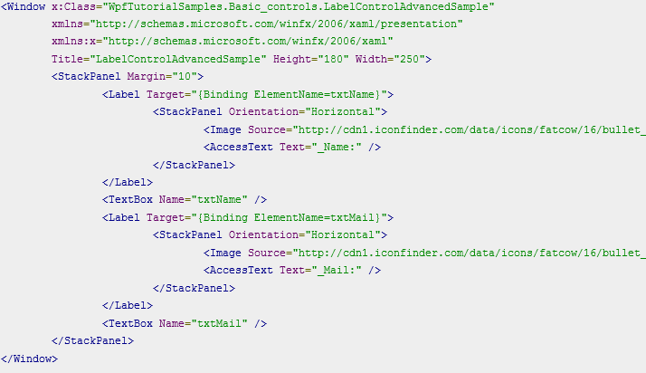
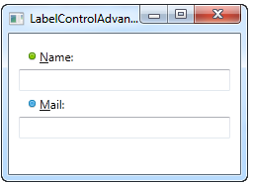
Using controls as label content
we have both an image and a piece of text inside the Label, while also having an access key for each of the labels:

Slide 35
Using controls as label content
instead of a simple text string, our Label will now host both and image and a piece of text (inside the AccessText control, which allows us to still use an access key for the label).
both controls are inside a horizontal StackPanel, since the Label, just like any other ContentControl derivate, can only host one direct child control.

Slide 36
WPF Panels
Panels act as containers for other controls and control the layout of your windows/pages
Since a window can only contain ONE child control, a panel is often used to divide up the space into areas, where each area can contain a control or another panel (which is also a control, of course)
Types of panels are:
Canvas
WrapPanel
StackPanel
DockPanel
Grid
UniformGrid

Slide 37
WPF Panels
Canvas - allows you to assign specific coordinates to each of the child controls, giving you total control of the layout (WinForms way of doing things)
WrapPanel - will position each of its child controls next to the other, horizontally (default) or vertically, until there is no more room, where it will wrap to the next line and then continue
StackPanel – acts much like the WrapPanel, but instead of wrapping if the child controls take up too much room, it simply expands itself, if possible. Can be either horizontal or vertical, but instead of adjusting the width or height of the child controls based on the largest item, each item is stretched to take up the full width or height
DockPanel - allows you to dock the child controls to the top, bottom, left or right. By default, the last control, if not given a specific dock position, will fill the remaining space
Grid - A Grid can contain multiple rows and columns. You define a height for each of the rows and a width for each of the columns, in either an absolute amount of pixels, in a percentage of the available space or as auto, where the row or column will automatically adjust its size depending on the content
UniformGrid - just like the Grid, with the possibility of multiple rows and columns, but with one important difference: All rows and columns will have the same size

Slide 38
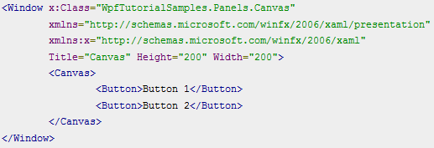
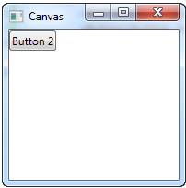
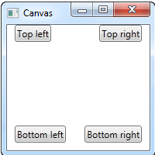
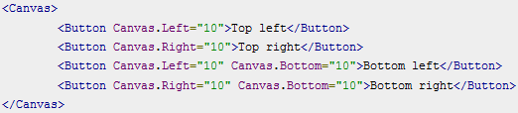
Canvas Panel
just allows you to put controls in it and then position them yourself using explicit coordinates
Both buttons placed in exactly the same place. Need to give co-ords to child controls using the Left, Right, Top and Bottom properties

Slide 39
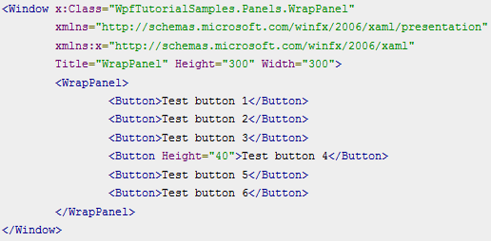
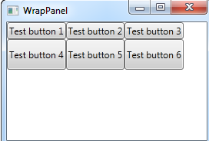
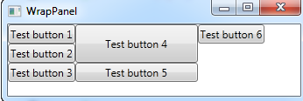
WrapPanel
in the Horizontal orientation, the child controls will be given the same height, based on the tallest item.
in the Vertical orientation, the child controls will be given the same width, based on the widest item
be aware that while the Horizontal WrapPanel will match the height in the same row and the Vertical WrapPanel will match the width in the same column, height is not matched in a Vertical WrapPanel and width is not matched in a Horizontal WrapPanel. Take a look in this example, which is the Vertical WrapPanel but where the fourth button gets a custom width AND height

Slide 40
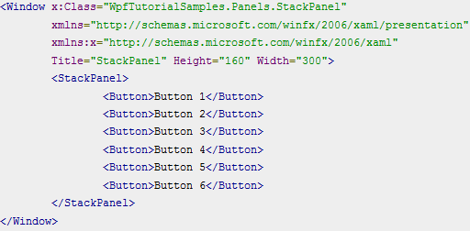
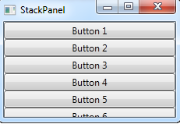
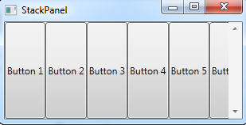
StackPanel
The StackPanel doesn't wrap the content. Instead it stretches it content in one direction, allowing you to stack item after item on top of each other
notice is how the StackPanel doesn't really care whether or not there's enough room for the content. It doesn't wrap the content in any way and it doesn't automatically provide you with the ability to scroll (you can use a ScrollViewer control for that)
Default orientation is vertical, but it can be changed to horizontal

Slide 41
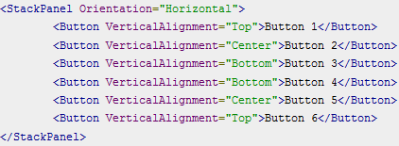
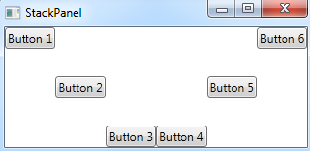
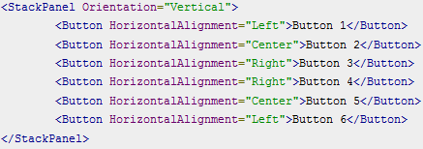
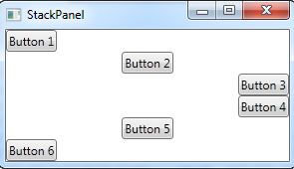
StackPanel
StackPanel stretches its child control by default. On a vertically aligned StackPanel, all child controls get stretched horizontally and vice-versa.. This is done by setting the HorizontalAlignment or VerticalAlignment property on its child controls to Stretch, but you can override this if you want to

Slide 42
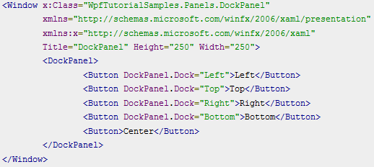
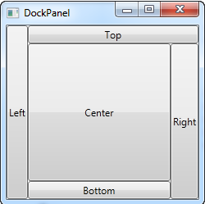
DockPanel
dock content in all four directions - top, bottom, left and right
by default, the last element inside the DockPanel, will automatically fill the rest of the space (centre)

Slide 43
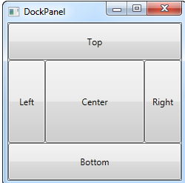
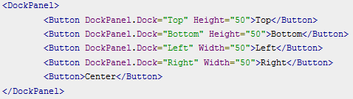
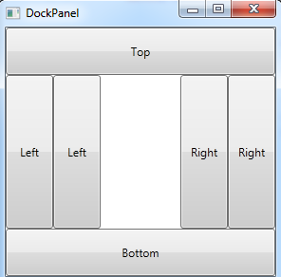
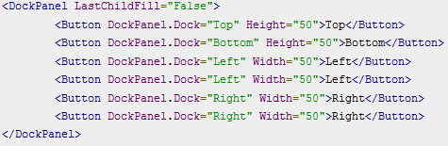
DockPanel
We can even out the space a bit by assigning widths/heights to the child controls
last child of the DockPanel takes up the rest of the space, but this can be disabled using the LastChildFill. Here's an example where we disable it, and at the same time we'll show the ability to dock more than one control to the same side

Slide 44
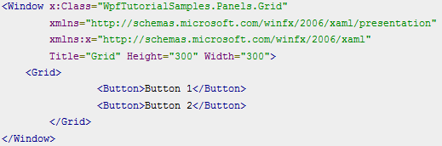
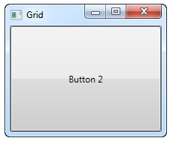
Grid Panel
can contain multiple rows and columns. You define a height for each of the rows and a width for each of the columns, in either an absolute amount of pixels, in a percentage of the available space or as auto, where the row or column will automatically adjust its size depending on the content.
In its most basic form, the Grid will simply take all of the controls you put into it, stretch them to use the maximum available space and place it on top of each other
the last control gets the top position, which in this case means that you can't even see the first button.
We can divide the space using ColumnDefinitions and RowDefinitions

Slide 45
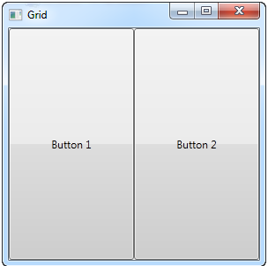
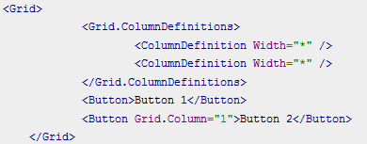
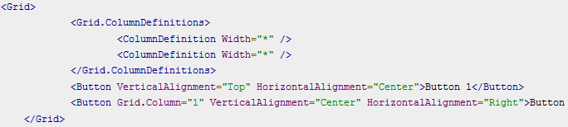
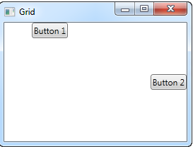
Grid Panel
Example of dividing into columns:
Space is shared equally using a “star” width.
By default the first button is placed in the first column (0) so we don’t need to specify the position
In some situations you may want them to only take up the space they need and/or control how they are placed in the Grid. The easiest way to do this is to set the HorizontalAlignment and VerticalAlignment directly on the controls you wish to manipulate

Slide 46
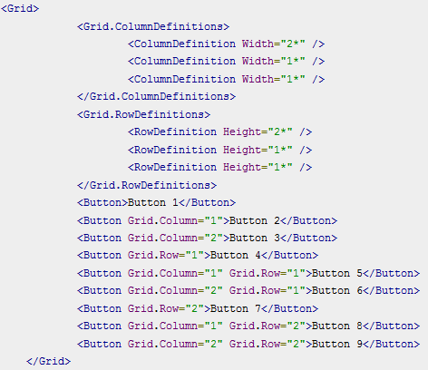

Grid Panel – rows and columns
2* basically means that it uses twice the amount of space as the rows and columns with a width of 1* (or simply *)

Slide 47


Grid Panel - units
we have used the star width/height, which specifies that a row or a column should take up a certain percentage of the combined space
two other ways of specifying the width or height of a column or a row - Absolute units and the Auto width/height.
the second button only takes exactly the amount of space it needs to render its longer text, the third button takes exactly the 100 pixels it was promised and the first button, with the variable width, takes the rest.
In a Grid where one or several columns (or rows) have a variable (star) width, they automatically get to share the width/height not already used by the columns/rows which uses an absolute or Auto width/height

Slide 48




Grid Panel - spanning
default Grid behaviour is that each control takes up one cell, but a control can take up more rows or columns – ColumnSpan, RowSpan (default of 1)

Slide 49




Grid Panel - GridSplitter
Grid panel makes it very easy to divide up the available space into individual cells, but what if you want to allow the user to change this?
The GridSplitter is used simply by adding it to a column or a row in a Grid, with the proper amount of space for it, e.g. 5 pixels. It will then allow the user to drag it from side to side or up and down, while changing the size of the column or row on each of the sides of it

Slide 50


Using Grid as a contact form

Slide 51
WPF Data Binding
Data binding is general technique that binds two data/information sources together and maintains synchronization of data
Data binding in WPF is the preferred way to bring data from your code to the UI layer. Sure, you can set properties on a control manually or you can populate a ListBox by adding items to it from a loop, but the cleanest and purest WPF way is to add a binding between the source and the destination UI element

Slide 52


WPF Data Binding
we bind the value of the TextBlock to match the Text property of the TextBox. As you can see from the screenshot, the TextBlock is automatically updated when you enter text into the TextBox. In a non-bound world, this would require us to listen to an event on the TextBox and then update the TextBlock each time the text changes, but with data binding, this connection can be established just by using markup

Slide 53

Syntax of a binding
It is defined between the curly braces, which in XAML encapsulates a Markup Extension
For data binding, we use the Binding extension, which allows us to describe the binding relationship for the Text property. In its most simple form, a binding can look like this:

Slide 54
Using the DataContext property
DataContext is meant to be set to the data object it visualizes
DataContext property is the default source of your bindings, unless you specifically declare another source, like we did with the ElementName property
It's defined on the FrameworkElement class, which most UI controls, including the WPF Window, inherits from. Simply put, it allows you to specify a basis for your bindings
There's no default source for the DataContext property (it's simply null from the start), but since a DataContext is inherited down through the control hierarchy, you can set a DataContext for the Window itself and then use it throughout all of the child controls
Notes:
https://www.tutorialspoint.com/wpf/wpf_data_binding.htm

Slide 55



Using DataContext example

Slide 56
DataContent example explained
In the code-behind file, after the standard InitalizeComponent() call, we assign the "this" reference to the DataContext, which basically just tells the Window that we want itself to be the data context.
In the XAML, we use this fact to bind to several of the Window properties, including Title, Width and Height. Since the window has a DataContext, which is passed down to the child controls, we don't have to define a source on each of the bindings - we just use the values as if they were globally available.
Try running the example and resize the window - you will see that the dimension changes are immediately reflected in the textboxes. You can also try writing a different title in the first textbox, but you might be surprised to see that this change is not reflected immediately. Instead, you have to move the focus to another control before the change is applied. Why? - UpdateSourceTriggerProperty

Slide 57
Data binding – UpdateSourceTrigger Property
changes in the TextBox was not immediately sent back to the source, the source was updated only after focus was lost on the TextBox. This behavior is controlled by a property on the binding called UpdateSourceTrigger.
It defaults to the value "Default", which basically means that the source is updated based on the property that you bind to. As of writing, all properties except for the Text property, is updated as soon as the property changes (PropertyChanged), while the Text property is updated when focus on the destination element is lost (LostFocus)
Default is, obviously, the default value of the UpdateSourceTrigger. The other options are PropertyChanged, LostFocus and Explicit. The first two has already been described, while the last one simply means that the update has to be pushed manually through to occur, using a call to UpdateSource on the Binding.

Slide 58




UpdateSourceTrigger example

Slide 59
UpdateSourceTrigger example explained
The first one is set to Explicit, which basically means that the source won't be updated unless you manually do it. For that reason, I have added a button next to the TextBox, which will update the source value on demand. In the Code-behind, you will find the Click handler, where we use a couple of lines of code to get the binding from the destination control and then call the UpdateSource() method on it.
The second TextBox uses the LostFocus value, which is actually the default for a Text binding. It means that the source value will be updated each time the destination control loses focus.
The third and last TextBox uses the PropertyChanged value, which means that the source value will be updated each time the bound property changes, which it does in this case as soon as the text changes.
Try running the example on your own machine and see how the three textboxes act completely different: The first value doesn't update before you click the button, the second value isn't updated until you leave the TextBox, while the third value updates automatically on each keystroke, text change etc.

Slide 60
Data binding – source changes
We have created bindings between UI elements and existing classes, but in real life applications, you will be binding to your own data objects. In this case, changes are not automatically reflected, like they were in previous examples
2 scenarios when dealing with data source changes
Changes to the list of items
Changes in the bound properties in each of the data objects
To help with this, WPF comes with the ObservableCollection and the INotifyPropertyChanged interface

Slide 61




Data binding – source changes
nothing in the UI is updated when you use the buttons!

Slide 62
Fixing the source change problem
Step 1
get the UI to respond to changes in the list source (ItemsSource). What we need is a list that notifies any destinations of changes to its content, and fortunately, WPF provides a type of list that will do just that. It's called ObservableCollection, and you use it much like a regular List<T>, with only a few differences.
In the final example, which you will find below, we have simply replaced the List<User> with an ObservableCollection<User> - that's all it takes! This will make the Add and Delete button work, but it won't do anything for the "Change name" button, because the change will happen on the bound data object itself and not the source list - the second step will handle that scenario though.
Step 2
The second step is to let our custom User class implement the INotifyPropertyChanged interface. By doing that, our User objects are capable of alerting the UI layer of changes to its properties. This is a bit more cumbersome than just changing the list type, like we did above, but it's still one of the simplest way to accomplish these automatic updates.

Slide 63


Solution

Slide 64



Slide 65
Data binding when data types not compatible
run into situations where you want to use a bound value of one type and then present it slightly differently
Value converters are very frequently used with data bindings. Here are some basic examples:
You have a numeric value but you want to show zero values in one way and positive numbers in another way
You want to check a CheckBox based on a value, but the value is a string like "yes" or "no" instead of a Boolean value
You may want to check a checkbox based on a Boolean value, but you want it reversed, so that the CheckBox is checked if the value is false and not checked if the value is true. You can even use a converter to generate an image for an ImageSource, based on the value, like a green sign for true or a red sign for false
For cases like this, you can use a value converter. These small classes, which implement the IValueConverter interface, will act like middlemen and translate a value between the source and the destination

Slide 66


Value Convertor
You need to implement the IValueConverter interface, or alternatively, the IMultiValueConverter interface
Both interfaces just requires you to implement two methods: Convert() and ConvertBack()
e.g. take a string as input and then return a Boolean value, as well as the other way around
we start off by declaring an instance of our converter as a resource for the window. We then have a TextBox, a couple of TextBlocks and a CheckBox control and this is where the interesting things are happening: We bind the value of the TextBox to the TextBlock and the CheckBox control and using the Converter property and our own converter reference, we juggle the values back and forth between a string and a Boolean value, depending on what's needed

Slide 67





Value Convertor

Slide 68


StringFormat Property
where you just want to change the way a certain value is shown and not necessarily convert it into a different type, the StringFormat property might very well be enough
It formats the output string, simply by calling the String.Format method
The first couple of TextBlock's gets their value by binding to the parent Window and getting its width and height.
For the width, we specify a custom formatting string and for the height, we ask it to use the currency format. The value is saved as a double type, so we can use all the same format specifiers as if we had called double.ToString().
notice how I can include custom text in the StringFormat - this allows you to pre/post-fix the bound value with text as you please. When referencing the actual value inside the format string, we surround it by a set of curly braces, which includes two values: A reference to the value we want to format (value number 0, which is the first possible value) and the format string, separated by a colon.
For the last two values, we simply bind to the current date (DateTime.Now) and the output it first as a date, in a specific format, and then as the time (hours and minutes), again using our own, pre-defined format

